Slide 1

OVER VOLTAGE AND UNDER VOITAGE PROTECTION
PROJECT TITTLE :
By:
A.DINESH 21030-EE-010
CH.RAJASEKHAR 21030-EE-049
D.SRIRAM 21030-EE-053
D.DONDI 21030-EE-054
CH.RAGHAVA 21030-EE-045
JOEL.R 21030-EE-038

Slide 2
INTRODUCTION
The sudden instability in voltage is colossal and noteworthy issue in undertakings and homes ,it causes hardships and moreover hurt the electrical circuit. These incidents cause low impact factor in the supply and by much proportion of impact will be misused. What's more, besides impact the unfaltering nature of other voltage controlling devices. Voltage swells and over voltage conditions are about caused by a sudden reduction in stack. Right when RMS voltage or current drops in the region of 0.1 and 0.9 pu at the power recurrence for the ranges of 0.5 cycles to 1 minute then it is said to be hang condition. The swell condition will happen when RMS voltage or current climbs in the region of 1.1 and 1.8 pu at the power repeat for lengths of 0.5 to 1 minute. Or then again more the 1.8pu and underneath circuit with a hurt voltage controller, notwithstanding the way that they can in like manner be caused by a hurt or free impartial affiliation.

Slide 3
HARDWARE IMPLEMENTATION
12v 1A SMPS power supply
LED
BUZZER
RELAY
PCB MAKING
POWER SUPPLY 2
POWER SUPPLY
ARDUINO UNO
SOFTWARE IMPLIMENTATION
Software programe

Slide 4
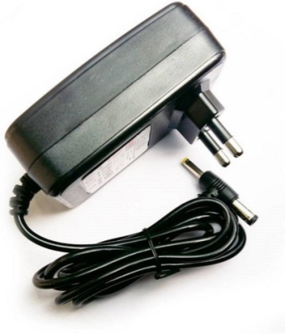
What is 12V 1A SMPS Power Supply ?
A 12V 1A SMPS (Switched Mode Power Supply) is an electronic device that provides a stable and regulated direct current (DC) output voltage of 12 volts with a maximum output current of 1 ampere.
These power supplies are commonly used to deliver power to various electronic devices, such as routers, modems, LED lighting systems, and low-power electronics. The term "switched mode" in SMPS refers to the efficient switching technology it employs to regulate voltage and current, making it more energy-efficient and compact compared to traditional linear power supplies.

Slide 5
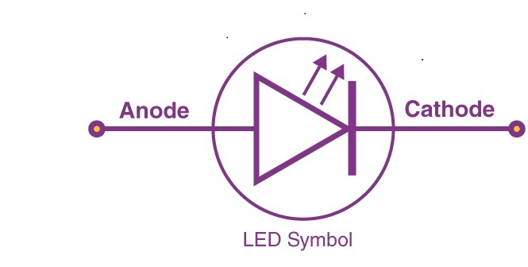
What is LED?
Symbol
"LED" typically stands for "Light Emitting Diode." It is a semiconductor device that emits light when an electric current passes through it. LEDs are commonly used in various applications, including displays, indicators, lighting, and more, due to their energy efficiency and long lifespan
When electrons within the semiconductor material recombine with electron holes, they release energy in the form of photons, creating light. LEDs are known for their exceptional energy efficiency, durability, and versatility.

Slide 6
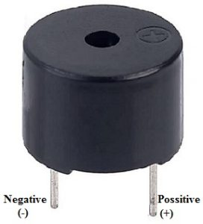
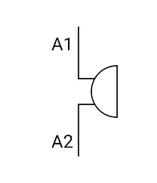
What is Buzzer?
Buzzer Symbol:
A buzzer is a simple electrocoaustic device designed to produce a buzzing or beeping sound when an electrical current is applied to it. It consists of a coil of wire wound around a magnetic core and a diaphragm or vibrating element, typically made of metal or plastic. When an electrical voltage is applied to the coil, it generates a magnetic field that interacts with the magnetic core. This interaction causes the diaphragm to vibrate rapidly, producing sound waves.
Buzzer devices are commonly used in a wide range of applications, from alarm systems and timers to electronic games and appliances, to provide audible alerts or notifications. Their simplicity and reliability make them a popular choice for signaling purposes in various electronic and industrial settings.

Slide 7
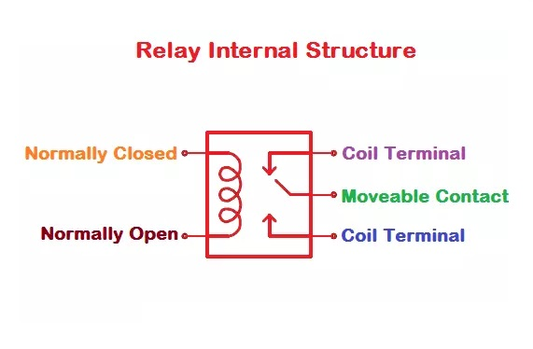
What is Relay?
When a small voltage is applied to the coil, it generates a magnetic field that attracts a movable armature, which is mechanically connected to one or more switch contacts. This magnetic force causes the switch contacts to change position, either opening or closing an electrical circuit. Relays are crucial in situations where you need to isolate or protect low-voltage control systems from high-voltage or high-current loads, making them an essential component in automation, robotics, industrial control, and many other applications.
A relay is an electromechanical switch that operates by using an electromagnetic coil to control the switching of one or more electrical circuits. It serves as an interface between low-voltage control signals, such as those from microcontrollers or digital logic circuits, and high-voltage or high-current loads, like motors, lights, or appliances
Relays provide safe and reliable way to control electrical devices remotely or based on specific conditions.

Slide 8
MAKING OF PCB:
One of the most discouraging things about making a hardware project is building the printed circuit board-PCB.it is sometimes possible to use strip board or some other pre-fabricated board but more often than not the circuit complexity and performance requires a proper PCB to be made .The good news is that due to improvements in printing and processing technologies it is now relatively easy to make inexpensive high quality PCB’s at home.
process
THE ARTWORK
THE ETCHING
DRILLING

Slide 9
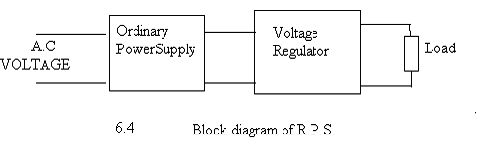
Power supply:
The supply given is the +5V D.C. The incoming power is 230V A.C. , there is a need to convert it into +5V D.C.
The input a.c. supply is stepped down from 230V to 9-0-9V. The rectifier consists of diodes D1 and D2 makes the supply D.C. that is, unidirectional waveform. The output from rectifier is a URDC, whose value is 12.726V peak to peak. The voltage regulator makes this URDC to RDC of +5V.
A regulated power supply which maintains the output voltage constant irrespective of a.c. mains fluctuations or load variations is known as regulated power supply. A regulated power supply consists of an ordinary power supply and voltage regulating device. The output of ordinary power supply is fed to the voltage regulator which produces the final output. The output voltage remains constant whether the load current changes or there are fluctuations in the input a.c. voltage.

Slide 10
ARDUNO
Arduino is an open source computer hardware and software company, project, and user community that designs and manufactures single-board microcontrollers and microcontroller kits for building digital devices and interactive objects that can sense and control objects in the physical world. The project's products are distributed as open-source hardware and software, which are licensed under the GNU Lesser General Public License (LGPL) or the GNU General Public License (GPL),^{[1]} permitting the manufacture of Arduino boards and software distribution by anyone. Arduino boards are available commercially in preassembled form, or as do-it-yourself (DIY) kits.
Arduino board designs use a variety of microprocessors and controllers. The boards are equipped with sets of digital and analog input/output (I/O) pins that may be interfaced to various expansion boards (shields) and other circuits. The boards feature serial communications interfaces, including Universal Serial Bus (USB) on some models, which are also used for loading programs from personal computers

Slide 11
Application of Over Voltage and Under Voltage
It is used in the home appliances, industries to control the voltage fluctuations
Protection of sensitive electronic devices
Agriculture motors
Water pumps

Slide 12
Advantages of Over Voltage and Under Voltage
The price of this circuit is very less and reliable
It can handle heavy loads up to 7A
In the abnormal condition automatically the switch is OFF state
In the safe condition automatically the switch is in the ON-state
These are highly sensitive

Slide 13
CONCLUSION : -
IT HAS BEEN DISCUSSED THAT UNDERVOLTAGE AND OVERVOLTAGE PROBLEMS ARE VERY COMMON AND CAN CREATE PROBLEMS FOR CONSUMER GOODS AND INDUSTRIAL APPLICATIONS. SO A SYSTEM HAS BEEN MODELED USING RELAY AND COMPARATOR AND IT IS FOUND TO BE GOOD IN DISCONNECTING THE SUPPLY WHEN IF SEES ANY OF THE ABOVE PROBLEMS.

